Slide 1





Green University of Bangladesh
Department Of Computer Science and Engineering(CSE)
Course Title: Data Communication Lab
Course Code: CSE 308 Section: 222 D3
Presented to
Mahbubur Rahman
Lecturer, Dept. of CSE
Green University Of Bangladesh

Slide 2


Md. Zahidul Islam
Md. Zahidul Islam
221902091
221902091

Slide 3





Welcome To Our Presentation
Basic Data Communication Live Code Implementation

Slide 4


Agenda
Introduction & Motivation
Objectives
Methodology
Result & Analysis
Tools & Techniques
Limitation & Future Scope
Conclusion

Slide 5

Introduction & Motivation
Importance of reliable data transmission in communication networks
Errors can corrupt data and cause malfunctions.
Need for techniques to ensure data integrity.
Enhancing understanding of communication protocols
Practical application of theoretical concepts

Slide 6

Objectives
01
02
03
To Showcase functionalities like bit stuffing, character stuffing, and IP conversions.
To Implement live code demonstrations of error detection and correction techniques.
To Provide a practical understanding of data communication principles.

Slide 7
Tools & Technology
Programming Language: Java
GUI Framework: Java Swing
Development Environment: Visual Studio Code (with Java Extension Pack)

Slide 8

Methodology
Run
Home
Reset
Home
Select Option
Bit Stuffing
Bit De-stuffing
Character Stuffing
Character de-stuffing
Dotted decimal to Binary
Binary to dotted Decimal
IP Information
IPv4 to IPv6
Parity Check
Hamming Encode
Hamming Decode
Error Detection
Input
Flag
Perform
Output

Slide 9


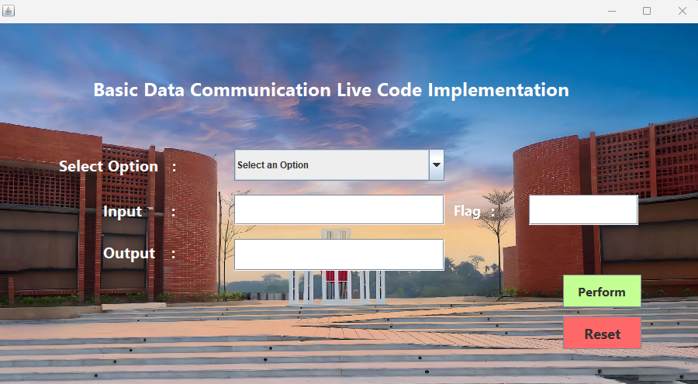

Result
Figure 01: Home

Slide 10
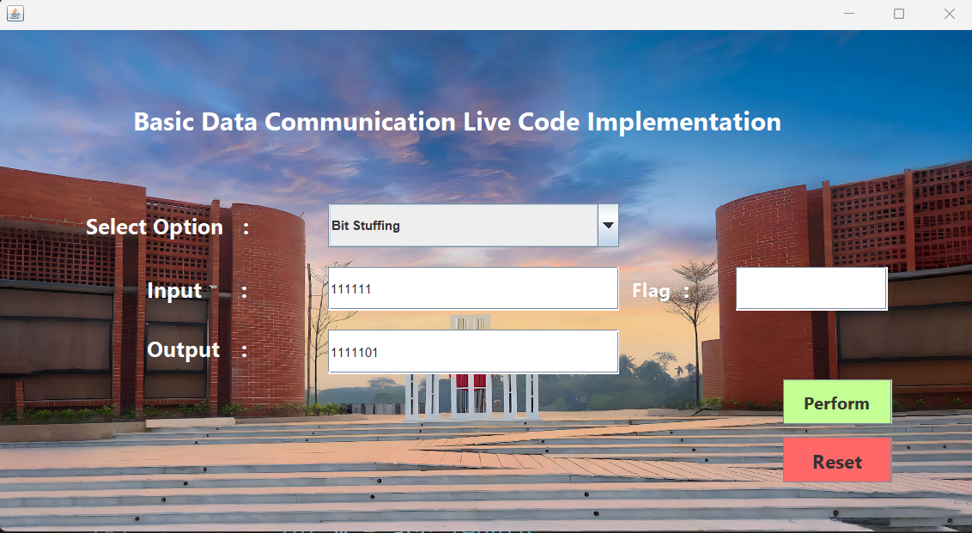
Result (Cont..)
Figure 02: Bit Stuffing

Slide 11

Result (Cont..)
Figure 03: Bit De-stuffing

Slide 12
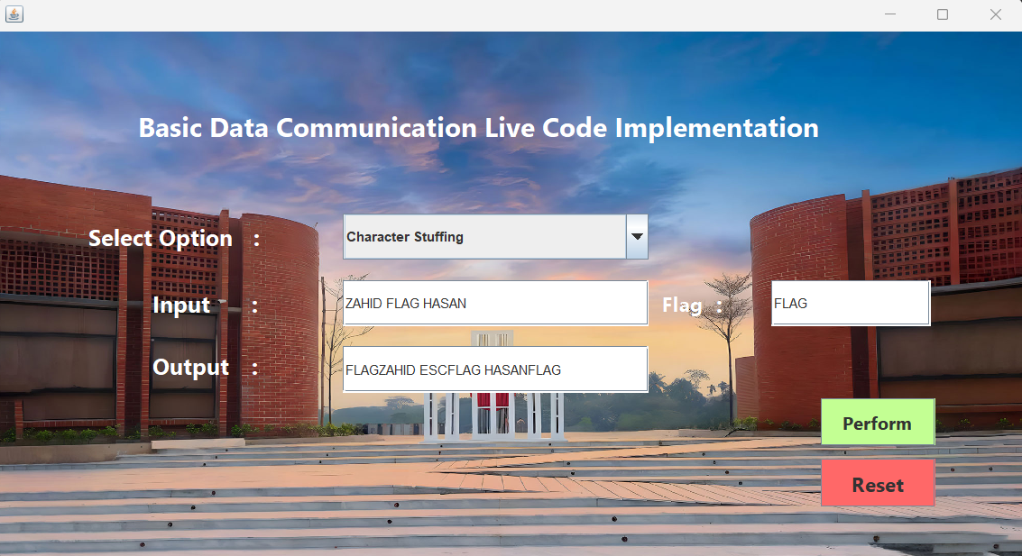
Result (Cont..)
Figure 04: Character stuffing

Slide 13

Result (Cont..)
Figure 05: Character De-stuffing

Slide 14

Result (Cont..)
Figure 06: Dotted decimal to Binary

Slide 15
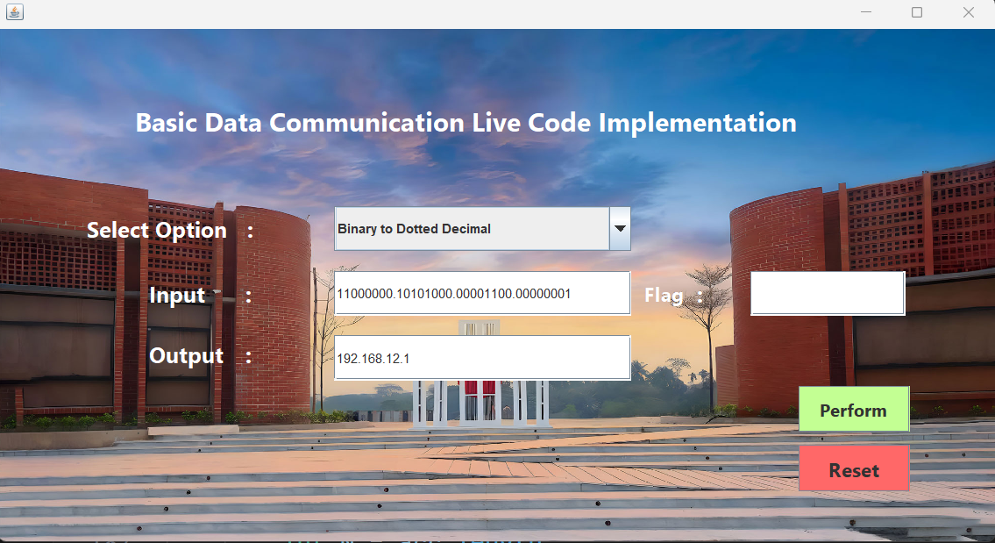
Result (Cont..)
Figure 07: Binary to Dotted decimal

Slide 16

Result (Cont..)
Figure 08: IP Information

Slide 17
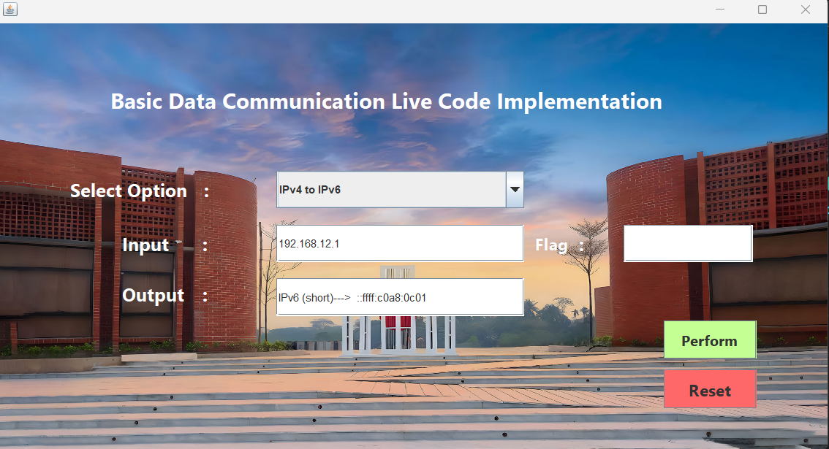
Result (Cont..)
Figure 09: IPv4 to IPv6

Slide 18

Result (Cont..)
Figure 10: Calculate Parity

Slide 19

Md. Mahim Hossain
221902082

Slide 20

Result (Cont..)
Figure 11: Hamming Encode

Slide 21

Result (Cont..)
Figure 12: Hamming Decode

Slide 22

Result (Cont..)
Figure 13: Error Detection

Slide 23


Limitation
Complexity of algorithms.
Limited scalability.
Dependency on specific patterns.

Slide 24


Future Scope
Algorithm optimization.
Limited scalability.
Simplification
Improved scalability for IP conversion techniques in large networks.

Slide 25


Conclusion

Slide 26

Thanks for Watching
Thanks everyone for being here – your presence means a lot!
Any Question, Just Ask don't be shy
Grateful for your presence! Thank you all!
The Team :
June 08, 2024

